Slide 1
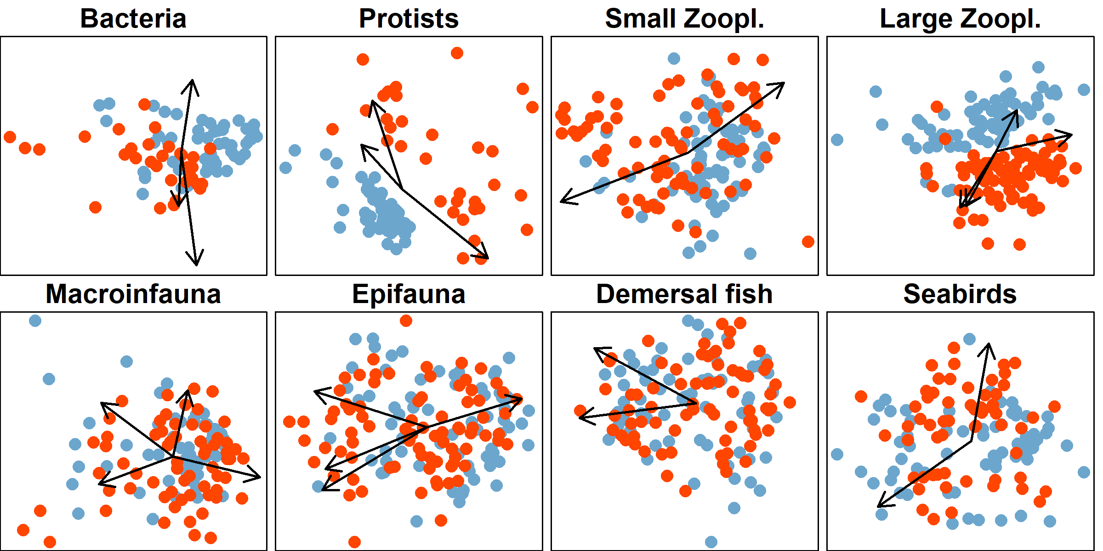
Melt fraction
BS
P
Chl
BS
Si
SSS
BT
SST
SST
SST, BT
BS
BT
pc2
pc1
BS
pc1
pc1
SST
SST
BS
BT
BT

Slide 2
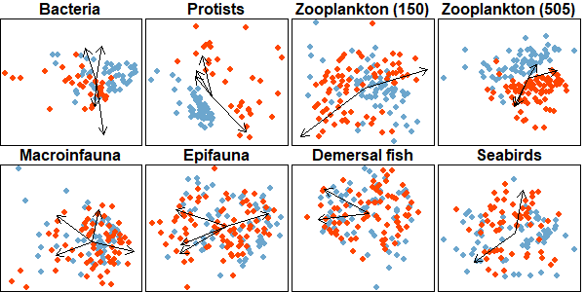
Original Submission May 2021
Melt fraction
P
P
N
BS
Chl
Si
BS
SSS
SST, BT
BT
SST
SST
BT
BS
pc2
pc1
pc1
BS
pc1
SST
SST
BS
BT
BT

